Slide 1

Employee Management System

Slide 2

EMPLOYEE MANAGEMENT SYSTEM
SQL based database project

Slide 3
Introduction
The Employee Management System focuses on efficient handling of employee, department, payroll, qualification, and leave data.
It helps organizations track employee records, salary details, and operational activities accurately.
The project simulates a real-world organizational database with interconnected tables and relationships.
SQL is used to store, retrieve, and analyze data for meaningful insights and reporting.
This project provides hands-on experience in database design and business data analysis.

Slide 4
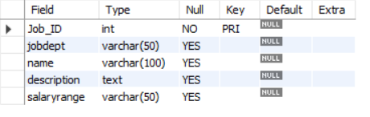
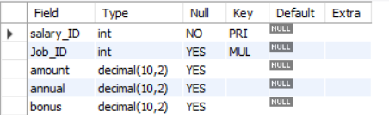
Tables
JobDepartment Table SalaryBonus Table

Slide 5
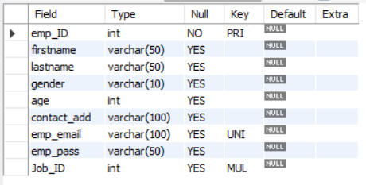
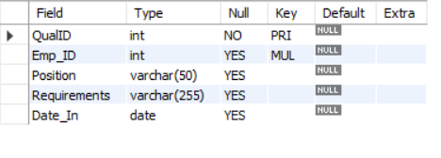
Employee Table Qualification Table

Slide 6
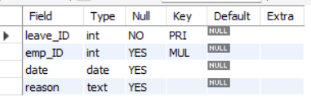
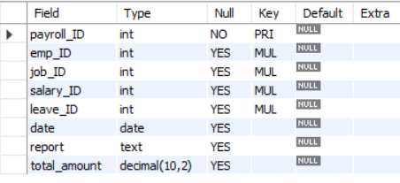
Leave Table PayRoll Table

Slide 7
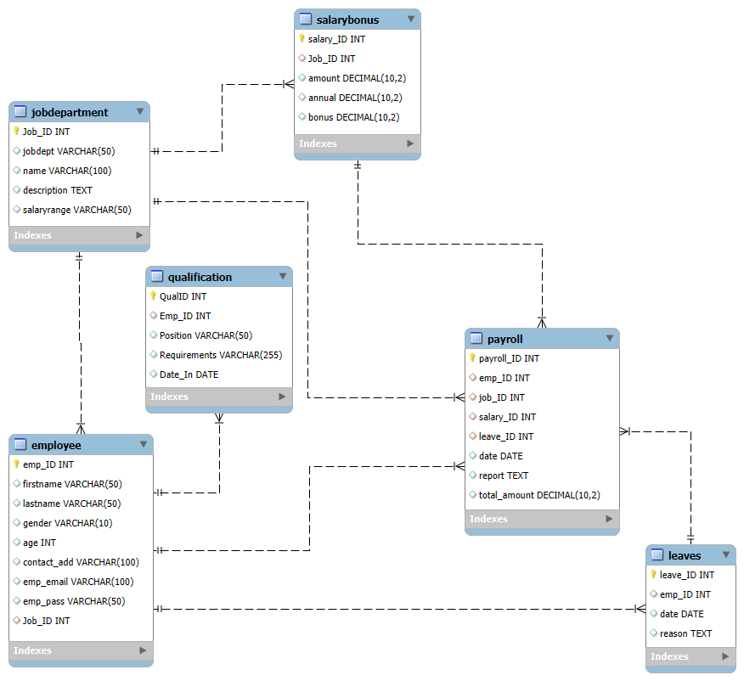
ER Diagram

Slide 8
Problem Statement
The objective of this project is to design and implement an Employee Management System that efficiently stores and manages employee-related data within an organization. The system needs to track various aspects of employee information, including personal details, job roles, salary structures, qualifications, leave records, and payroll data. The system should ensure the integrity and consistency of data by using relational tables with appropriate foreign keys and cascading actions.
The system allows for easy management and querying of employee data, providing insights such as payroll calculation, leave tracking, and department-specific job roles. The goal is to streamline HR operations, ensuring that all relevant employee data is accessible and accurately updated across different modules.

Slide 9


1. How many unique employees are currently in the system?

Slide 10
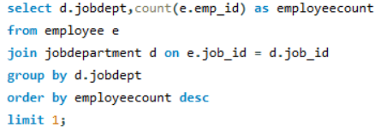

2. Which departments have the highest number of employees?

Slide 11

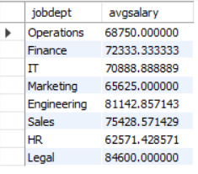
3. What is the average salary per department?

Slide 12
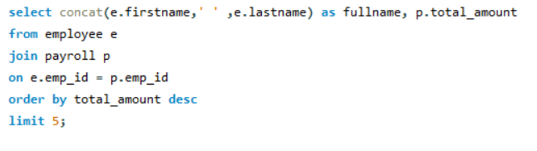
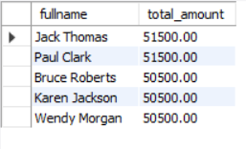
4. Who are the top 5 highest-paid employees?

Slide 13


5. What is the total salary expenditure across the company?

Slide 14
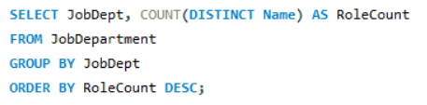
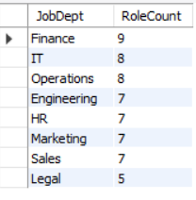
6. How many different job roles exist in each department?

Slide 15
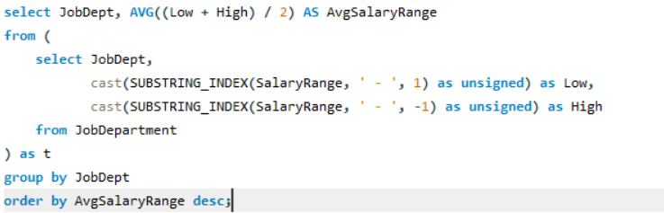
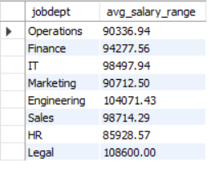
7. What is the average salary range per department?

Slide 16
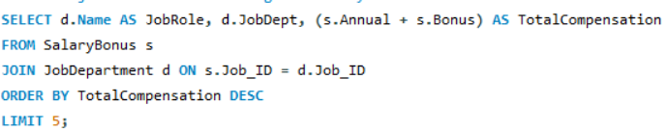
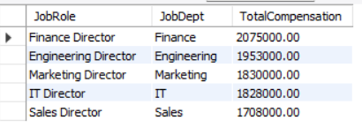
8. Which job roles offer the highest salary?

Slide 17
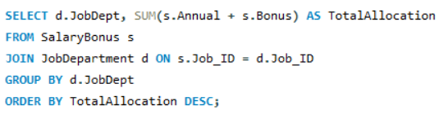
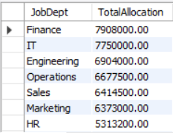
9. Which departments have the highest total salary allocation?

Slide 18


10. How many employees have at least one qualification listed?

Slide 19
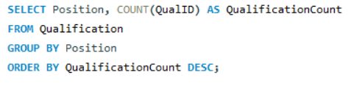
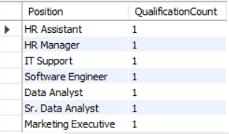
11. Which positions require the most qualifications?

Slide 20
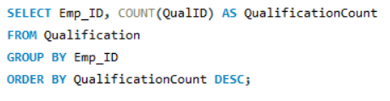
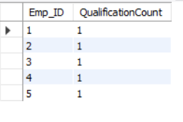
12. Which employees have the highest number of qualifications?

Slide 21
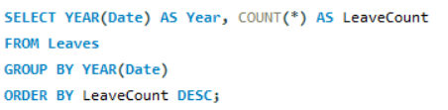

13. Which year had the most employees taking leaves?

Slide 22
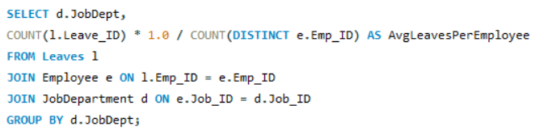
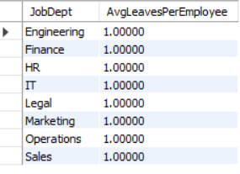
14. What is the average number of leave days taken by its employees per department?

Slide 23
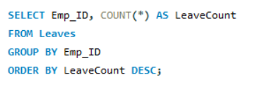
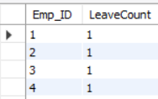
15. Which employees have taken the most leaves?

Slide 24


16. What is the total number of leave days taken company-wide?

Slide 25
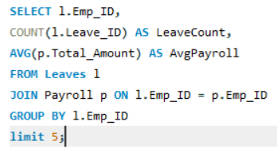
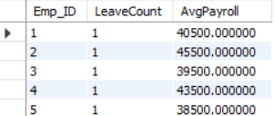
17. How do leave days correlate with payroll amounts?

Slide 26
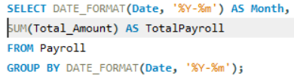

18. What is the total monthly payroll processed?

Slide 27
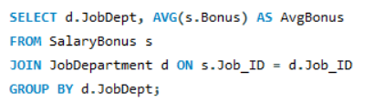
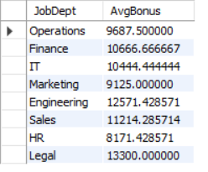
19. What is the average bonus given per department?

Slide 28
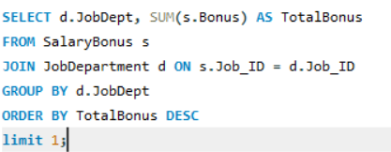

20. Which department receives the highest total bonuses?

Slide 29


21. What is the average value of total amount after considering leave deductions?

Slide 30
Thank You
Team Members
Saini Kavya
N. Rajeshwar
M. Venkat

